Slide 1
L12 – Limitations of Agile
FIT2101: Software Engineering Process and Management
S2 2020

Slide 2
In this lecture…
Common Agile pitfalls
Modern heavyweight approaches
Rational Unified Process
model-based approaches

Slide 3
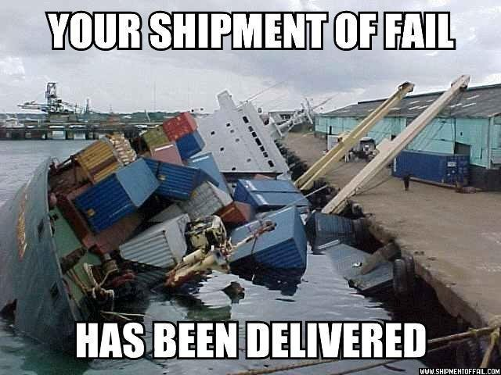
Ways Agile projects fail
Teams adopt Scrum or other Agile methodologies in the hope that it will help them succeed, but it doesn’t always work out that way. Let’s examine some of the common reasons Agile projects fail.

Slide 4

Higher management doesn’t get it
It’s not enough to put the team through a Scrum training course
The rest of the organization has expectations for reporting, budget etc.
Senior management might impose unAgile conditions on the team
frequent written reporting
frequent personnel changes
insisting on micromanaging the process
Notes:
If the way that the broader organization works isn’t compatible with an Agile process, then either you will need support from senior management (at least enough to waive some reporting and/or governance requirements) or you will need to use a traditional process. Higher management often tends to prefer command-and-control ways of working.

Slide 5

Team doesn’t collaborate well
Agile teams are self-organizing, so team members need to communicate well amongst themselves
who’s got which skills?
who’s got a lot to do, and who’s got spare capacity?
“Lone wolf” developers will find this challenging
and so will developers who are unduly competitive, who dislike or don’t know their teammates, etc.
Notes:
This sometimes has to do with incompatible expectations, but it can also be due to personality clashes or simple lack of maturity. It can help if you embed Agile novices in more experienced teams.

Slide 6
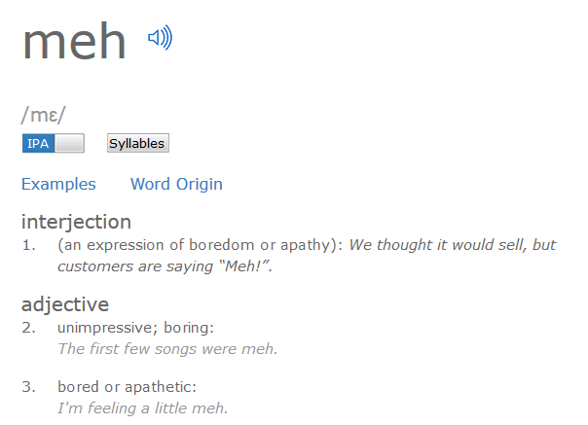
Customer isn’t interested
Agile processes require frequent input from a customer representative
If the customer wants to hand over a list of requirements and not hear from you again, Agile methods won’t work
If the customer wants to sign off on a requirements specification as part of your contract, Agile methods won’t be easy to apply
Notes:
There are things you can do about this. For example, you can delegate a Product Owner from within your organization to represent your customers’ interests. But the first thing you should do is consider whether the benefits of Agile development will outweigh the downsides, given that the requirements are less likely to change.

Slide 7
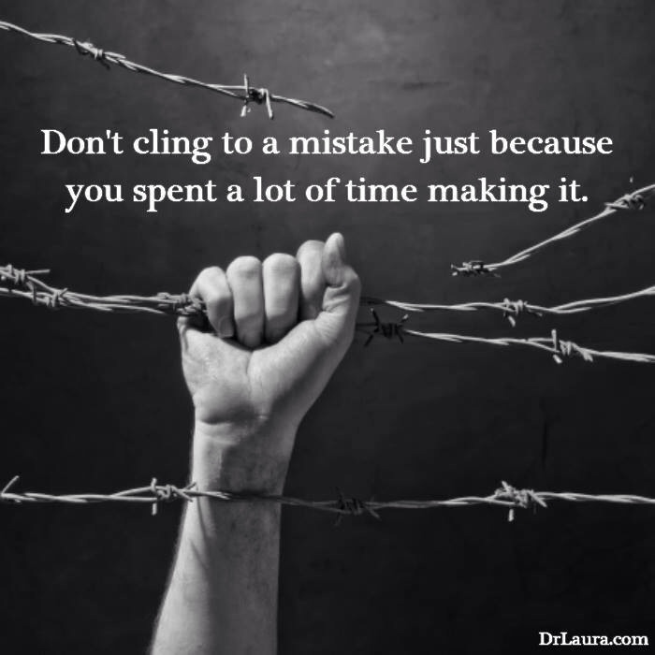
Team hangs on to their old ways
Moving from a traditional or ad-hoc process means changing a lot of things
responsibilities are decentralized
reporting requirements change
team is responsible for its own process improvement
testing is done more frequently
team does its own estimation
If team members are resistant to changing the way they work, or lack maturity to do it well, Agile processes won’t work
Notes:
This is one reason it’s a good idea to hire an Agile Coach, or retrain an existing staff member who shows interest and talent in that area. It will take a while for team members to get on board with the new way of doing things.

Slide 8
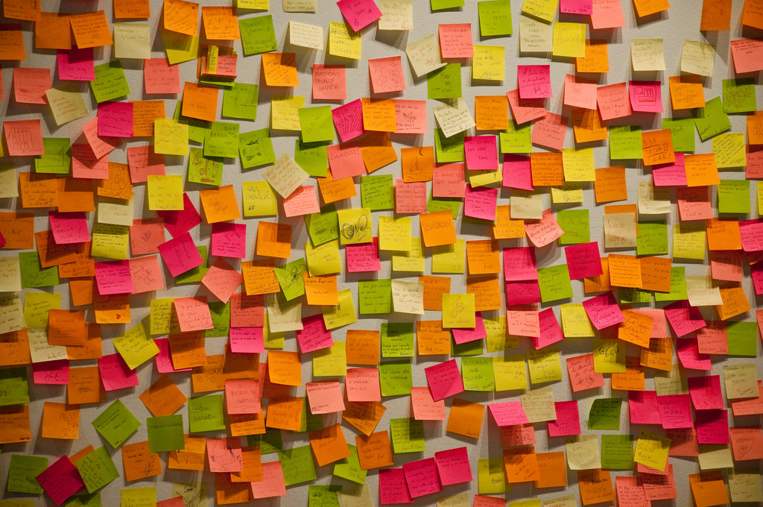
Overplanning
It can be hard to let go if your existing process requires a lot of planning
If you try to plan Agile development as rigorously as traditional development, you’ll lose the benefits
e.g. planning all iterations in detail during process inception
Similarly, it’s okay if the team’s estimates aren’t perfect
overestimates and underestimates will average out
address in retros if estimation is actually causing problems
Notes:
Again, if you’re used to a command-and-control process, letting go of that to embrace change can be really scary.

Slide 9
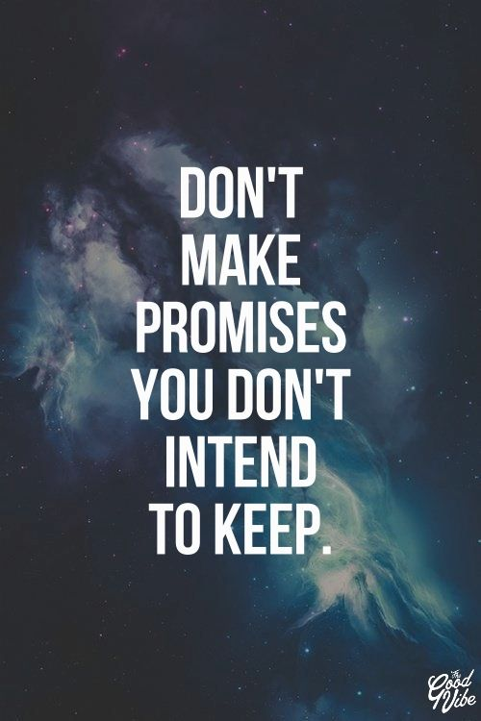
Unreasonable expectations
Expecting much faster development
Agile approaches can reduce wasted time, but can’t perform miracles
projects and teams will benefit from Agile to different extents
some won’t benefit at all
Expecting to be able to cope with no documentation or planning at all
just because you don’t write it down doesn’t mean you can get away without doing it
it is naïve to expect that a non-trivial project will succeed if attempted completely ad-hoc
Notes:
Agile processes require discipline in order to succeed, and any team going “agile” in the expectation that they’ll be able to do whatever they like is probably going to fail. Likewise, there are tradeoffs around flexibility: even if you embrace change and design for it, large changes to requirements late in development are still going to blow out the deadline.

Slide 10
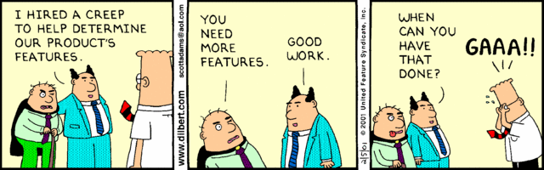
Scope creep
Agile processes put less effort into nailing down requirements at the start of the project
If the customer is unreasonable or overenthusiastic, this can lead to scope creep
the requirements keep expanding or shifting
so the project stops approaching completion
Team needs to say no to some new or changed user stories… but this can be difficult

Slide 11
When shouldn’t you use Agile?
When it’s a bad fit for your organization
organizational culture is opposed to uncertainty or change
you have a lot of reporting requirements
company structure requires a traditional Project Manager to be in charge
When it’s a bad fit for your customers
they don’t have time to spend with developers
they require a very predictable process
When it’s a bad fit for the product
needs a very large team, or has stringent quality requirements
requirements are known in advance, well-understood, and won’t change
When it’s a bad fit for the team
team can’t meet frequently (e.g. time zone differences)
team is very large
team doesn’t know one another well, or there is distrust
team lacks the maturity to self-manage

Slide 12

Beyond Agile
Agile methodologies can take us a long way, but they have their limits. Sometimes a project needs tighter control than Agile provides.
Notes:
This astronaut has been able to go a long way, but it wouldn’t be safe for him to try to move further away than the tether allows.

Slide 13
Alternatives to Agile
We briefly looked at some heavyweight process models in Week 1
But heavyweight processes have advanced since 2000
Let us review some modern heavyweight process models
the Rational Unified Process
Model Based Software Engineering
If interested in heavyweight processes, you should also review the material on Spiral from Week 1
Notes:
There is a paper on Spiral on this week’s Moodle page as well.
Barry Boehm believes that Scrum is a specific instance of Spiral that results from trying to accommodate requirements change within very tight spirals.

Slide 14
Rational Unified Process (RUP)
RUP is a family of iterative heavyweight process models that make extensive use of UML for documentation
Is a framework rather than a process
so many different processes can be called “RUP”
cf. many different processes can be called “Agile”: Scrum, Lean, Crystal, RAD, etc.
Developed at Rational (which was later bought by IBM)
so plenty of tool support available
Notes:
One of the architects of the RUP was Ivar Jacobsen, who was also one of the first people to systematize use cases. RUP also took on ideas from Grady Booch and James Rumbaugh, specifically to do with OO modelling – Booch and Rumbaugh were two of the primary architects of the UML.

Slide 15
RUP phases
RUP is broken down into four phases:
inception: define scope, elicit and clarify requirements, determine and manage risks, etc.
elaboration: figure out the architecture
construction: develop the software
transition: get software ready for release and deploy it
RUP iterations take place within these phases
At first glance, this looks like Waterfall…
key difference: Waterfall phases determine the activities the team does
RUP phases only determine the team’s objectives
e.g. RUP inception doesn’t only involve requirements elicitation activities
can involve coding up a prototype if needed for risk analysis

Slide 16
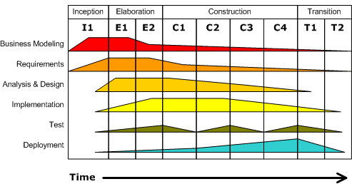
RUP phases and disciplines
This diagram shows how the effort in each phase may be divided between different activities. Note that other breakdowns are possible, e.g. if the team implements a prototype to clarify feasibility, there will be some implementation during the Inception phase.
Notes:
Disciplines are also known as “workflows” – this used to be the standard terminology in RUP, and older documents and textbooks still use it.

Slide 17
RUP phases and disciplines
Phases
This diagram shows how the effort in each phase may be divided between different activities. Note that other breakdowns are possible, e.g. if the team implements a prototype to clarify feasibility, there will be some implementation during the Inception phase.

Slide 18
RUP phases and disciplines
Iterations
This diagram shows how the effort in each phase may be divided between different activities. Note that other breakdowns are possible, e.g. if the team implements a prototype to clarify feasibility, there will be some implementation during the Inception phase.

Slide 19
RUP phases and disciplines
Disciplines
This diagram shows how the effort in each phase may be divided between different activities. Note that other breakdowns are possible, e.g. if the team implements a prototype to clarify feasibility, there will be some implementation during the Inception phase.

Slide 20
RUP and Agile
RUP is based around six underlying principles:
None of these are incompatible with Agile development!
RUP has been extended in light of experiences in the Agile world
is now compatible with (and has tool support for) practices such as pair programming and TDD
develop iteratively, with risk as the primary iteration driver
manage requirements
employ a component-based architecture
model software visually
continuously verify quality
control changes
Notes:
If you’re interested, there’s a variant on RUP called OpenUP that is designed for Agile teams.

Slide 21
Model Based Software Engineering (MBSE)
All approaches to software engineering use models
most use models to document the system during or after its construction
MBSE is centred around models
Idea: generate design from requirements, then automatically generate code from the design
design is usually embodied in UML or SysML
define structure using SysML block diagrams
define behaviour using statecharts, sequence diagrams, etc.
Agile process models tend to put less emphasis on design
MBSE puts more emphasis on design, to the exclusion of implementation
Notes:
SysML is short for “Systems Modelling Language”. It adopts some parts of the UML and adds its own extensions.
Why is this heavyweight? Because typically requirements are elicited up-front and then laboriously translated into a model. They are seldom, if ever, elicited one feature at a time.

Slide 22
MBSE in practice
MBSE has been used successfully for some applications
Airbus and Lockheed Martin have used it for flight control software
Works well for systems where the models are a good fit for the problem
Very useful where quality requirements are high and you need to prove that they are met
which is why MBSE is used in avionics
Not ideal if you need detailed control over implementation details
e.g. autogenerated user interfaces tend to be hard to fine-tune
Notes:
Joel Spolsky’s Law of Leaky Abstractions (https://www.joelonsoftware.com/2002/11/11/the-law-of-leaky-abstractions/) says that no matter how good your abstractions are, there’s always going to be edge cases or exception conditions where they “leak” – i.e. where the lower levels of abstraction become visible. For example, Java tries to abstract away from the idea of pointers by making references transparent, but the underlying pointers become visible if you try to access an object reference that hasn’t been instantiated – you get a NullPointerException. That means that Java programmers do need to understand how the language works – although it’s true that they don’t have to keep the implementation details in the forefront of their minds to the same extent as C programmers.

Slide 23
Summary
Limitations of Agile
When Agile isn’t for you…
Modern heavyweight process models
Rational Unified Process
Model-Based Software Engineering

Slide 24
Next lecture (don’t worry, it’s not in swotvac)
Look online for…
FIT2101 review
structure of the exam
how to approach an open book exam
FIT2101 topics

